Slide 1
Lambton College in Toronto
CBD 2214: Big Data Fundamentals
K Means Clustering
Team Members: Ralph Christian
Usnik Biswas
Ajay Sharma

Slide 2
Theory
Basics:
Clustering: It simply means creating groups of datasets based on common patterns and distance from each other on axis.

Slide 3
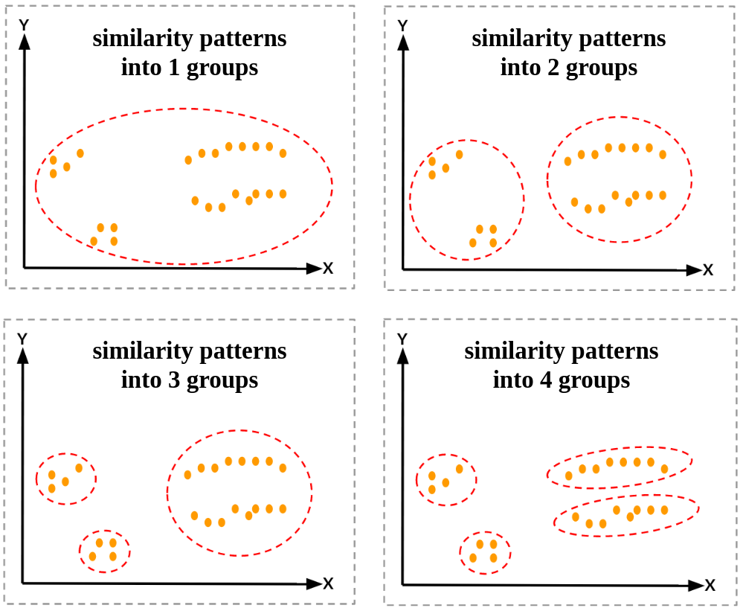

Slide 4
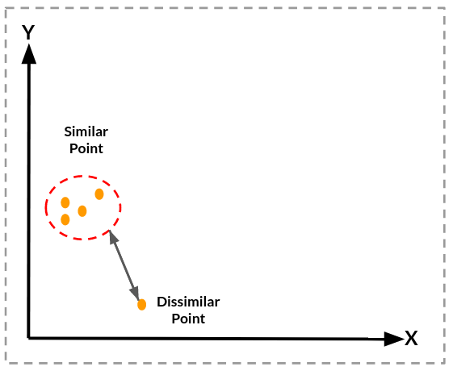
How are similar points calculated?
The similarity is calculated on basis of distance from one point to another.

Slide 5
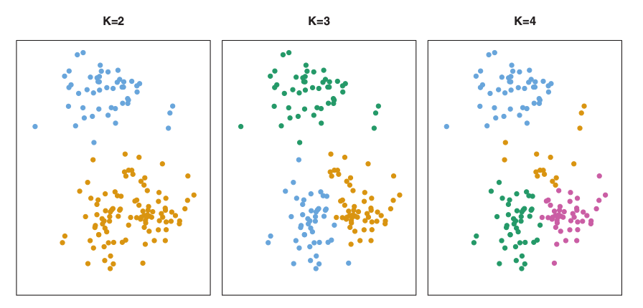
K Means Clustering
It is a simple and elegant method of separating and partitioning dataset into K clusters that do not overlap each other and are distinct.

Slide 6
Process
Step 1: Determine the value of K, that is, determine how many clusters should be formed.
Step 2: Create Centre Points, these point act as the basis for that entire cluster, hence the data involved in a particular cluster is dependent on the centre point.
Step 3: Based on the Euclidian Geometry, determine the distance between each point and the centre.
Step 4: Assign each data point to one cluster and calculate the mean of the clusters formed.

Slide 7
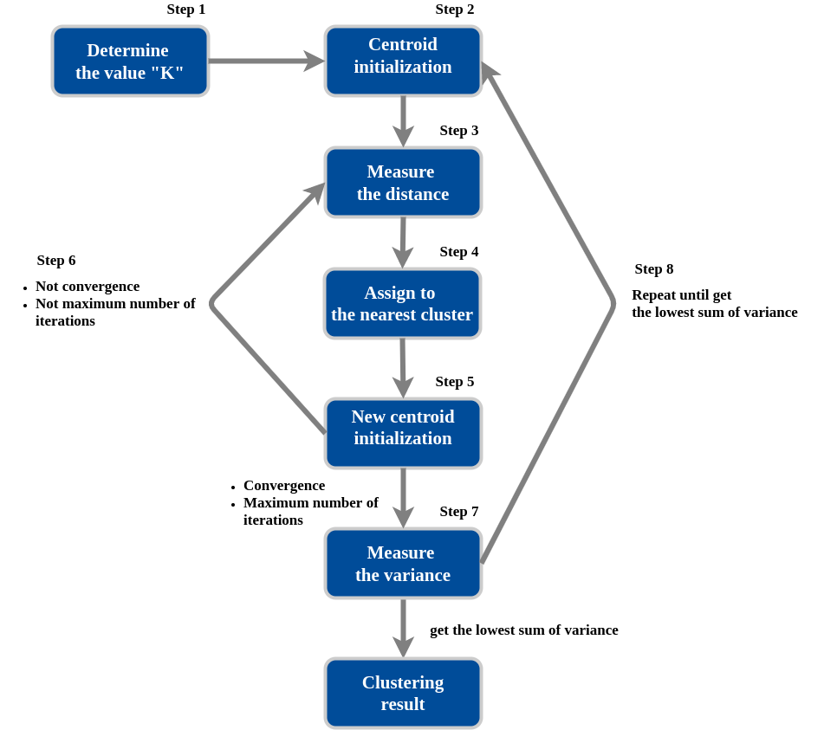

Slide 8
Data Set
Any type of prediction or analysis depends on the dataset that is given to the model, the data needs to be selected and collected from proper sources, and the data needs to be of high veracity to have better value.

Slide 9
CustomerID | Gender | Age | Annual Income (k$) | Spending Score (1-100)
0 | 1 | Male | 19 | 15 | 39
1 | 2 | Male | 21 | 15 | 81
2 | 3 | Female | 20 | 16 | 6
3 | 4 | Female | 23 | 16 | 77
4 | 5 | Female | 31 | 17 | 40

Slide 10
The data which we have selected is of individuals that is collected from a store, the store provides database which has 5 different columns.
Customer ID: Unique ID assigned to a user.
Gender: The gender of a person.
Age: Age of that person.
Annual Income: How much a person earns in a year.
Spending Score: How much a person spends at a store.

Slide 11
Pre-Processing Steps
Cleaning and Filtering Data.
sc_dfa = StandardScaler()
dfa_std = sc_dfa.fit_transform(dfa.astype(float))
## Declaring and calling KMeans

Slide 12
Dropping data that does not have sufficient data:
dfa.dropna()
dfa = dfa[['Age','Annual Income (k$)','Spending Score (1-100)']]
print('Total Row : ', len(dfa))

Slide 13
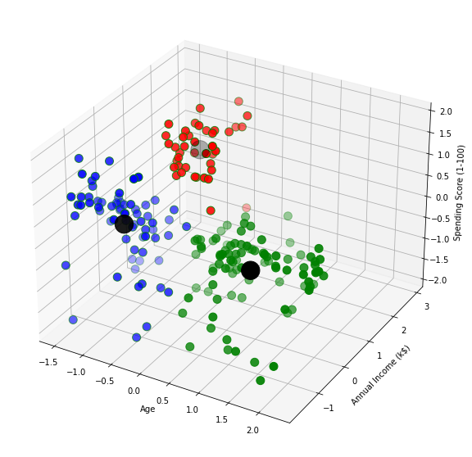

Slide 14
Interesting Results from the K Means Clustering:
Annual Income and Age: As age increases, annual income also increases, hence one cluster is formed in area where high income and age meets, however there is disparity in spending habits.
Low Age but High Income: The highest spending points are accumulated by this small number of individuals that have high income but are not that old.
Low Income: Low-income Low age individuals spend more than low income but old age individuals.

Slide 15
Practical Presentation

Slide 16
Thank You!

